Slide 1
Heap and heap sort
Reading: Chapter 9
Data Structures and Algorithms in Java

Slide 2
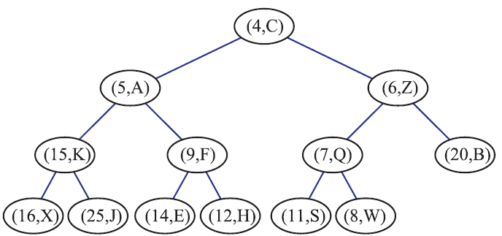
Heap
Heap is a data structure allows to perform both insertions and removals in logarithmic time by storing elements and keys in a binary tree
A heap is a binary tree T that stores a collection of elements with their associated keys at its nodes and that satisfies two additional properties:
Relational property, defined in terms of the way keys are stored in T.
In a heap T, for every node v other than the root, the key associated with v is greater than or equal to the key associated with v’s parent (this is also called a min-heap).

Slide 3
Heap
Structural property, defined in terms of the nodes of T itself
A heap T with height h is a complete binary tree, that is, levels 0, 1, 2, . . . , h−1 of T have the maximum number of nodes possible (namely, level i has 2^{i} nodes, for 0 ≤ i ≤ h−1) and the nodes at level h fill this level from left to right

Slide 4
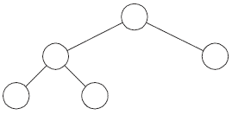
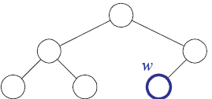
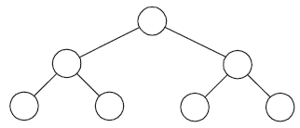
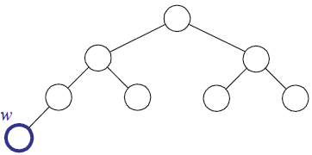
Add to Complete Binary Tree
If the bottom level of T is not full, then add inserts a new node on the bottom level of T, immediately after the rightmost node of this level; hence, T’s height remains the same.
If the bottom level is full, then add inserts a new node as the left child of the leftmost node of the bottom level of T; hence, T’s height increases by one.

Slide 5
Array Representation of a Complete Binary Tree
Nodes of T are stored in a array A such that node v in T is the element of A with index equal to the level number f (v) defined as follows:
If v is the root of T, then f (v) = 0
If v is the left child of node u, then f (v) = 2 f (u) + 1
If v is the right child of node u, then f (v) = 2 f (u) +2
w
w
0
1
2
3
4
5
0
1
2
3
4
5
6
7
add and remove can be performed in O(1) time because they simply involve adding or removing the last element of the vector.
space used by the Array-based representation of a complete binary tree with n nodes is O(n)

Slide 6
The Height of a Heap
A heap T storing n entries has height h = ⌊log n⌋.
Justification:
T is complete, then there are 2^{i} nodes in level, i for 0 ≤ i ≤ h−1, and level h has at least 1 node. Thus, the number of nodes of T is at least
(1+2+4+···+2^{h−1})+1 = (2^{h}−1)+1= 2^{h}.
Level h has at most 2^{h} nodes, and thus the number of nodes of T is at most
(1+2+4+···+2^{h−1})+2^{h} = 2^{h+1}−1.
Since the number of nodes is equal to the number n of entries, we obtain
2^{h} ≤ n and n ≤ 2^{h+1}−1.
Thus, by taking logarithms of both sides of these two inequalities, we see that
h ≤ log n and log(n+1)−1 ≤ h.
Since h is an integer, the two inequalities above imply that h = ⌊log n⌋.

Slide 7
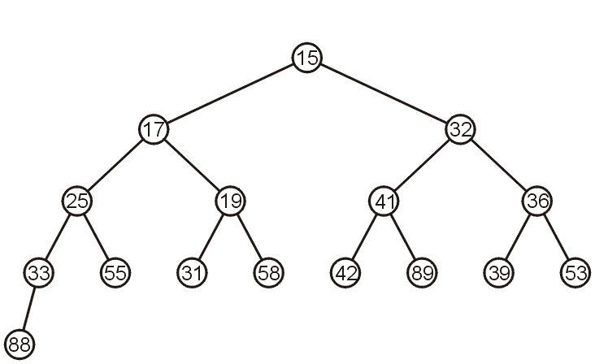

Heap Array Implementation
Associate an index, starting at 1, with each entry in the breadth-first traversal, to get:
Given the entry at index k, it follows that:
The parent of node is a (k-1)/2
The children are at 2k+1 and 2k + 2
0 | 1 | 2 | 3 | 4 | 5 | 6 | 7 | 8 | 9 | 10 | 11 | 12 | 13 | 14 | 15

Slide 8
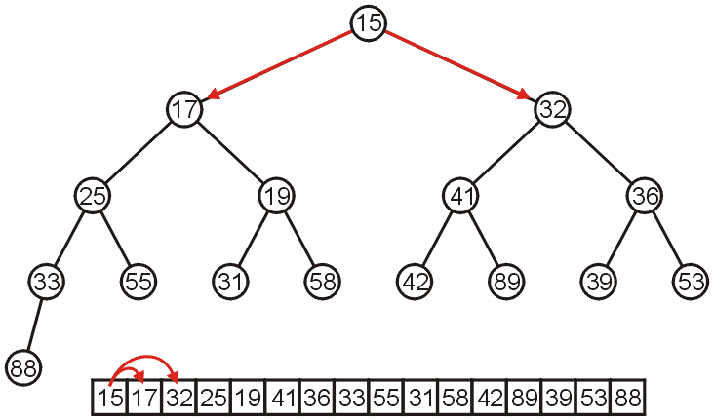
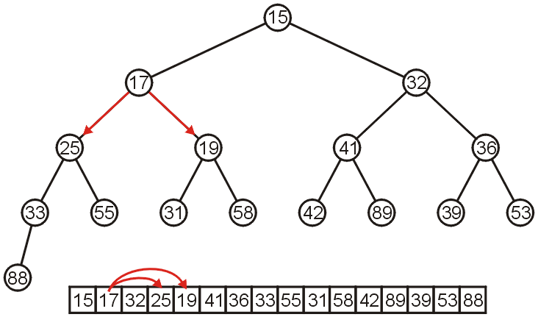
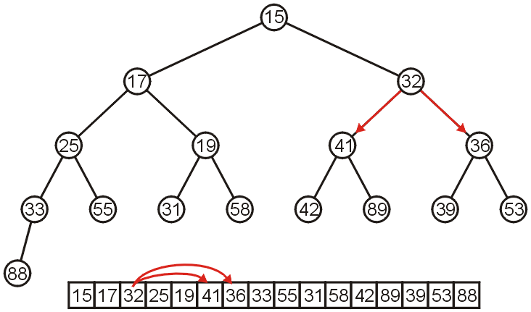
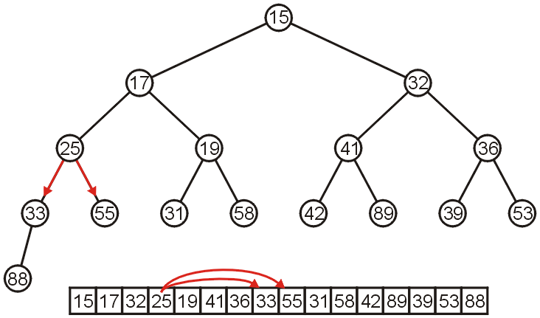
Array Implementation
The children of 15 are 17 and 32:
The children of 17 are 25 and 19:
The children of 32 are 41 and 36:
The children of 25 are 33 and 55:

Slide 9
Heaps and Priority Queues
We can use a heap to implement a priority queue
We store a (key, element) item at each internal node
We keep track of the last node
(2, Sue)
(5, Pat)
(6, Mark)
(9, Jeff)
(7, Anna)

Slide 10
Array Implementation-Insertion
If the heap-as-array has count entries, then the next empty node in the corresponding complete tree is at location n = count
Insert new node z at bottom of tree ( at location n )
Compare key of z with the key of its parent u (i.e., compare the item at location n with the item at (n-1)/2)
If k(z) ≥ k(u), the heap-order property is satisfied and the algorithm terminates.
Otherwise, we need to restore the heap-order property
Swap the entries stored at z and u, set n = (n-1)/2 (i.e., the new entry to move up one level
Repeat until root node is reached or the heap-order property is not violated
up-heap bubbling : the upward movement of the newly inserted entry by means of swaps

Slide 11
Insertion into a Heap
Method insert of the priority queue ADT corresponds to the insertion of a key k to the heap
The insertion algorithm consists of three steps
Find the insertion node z (the new last node)
Store k at z
Restore the heap-order property
2
5
z
6
9
7
insertion node
2
5
6
z
9
7
1
11

Slide 12
Upheap
After the insertion of a new key k, the heap-order property may be violated
Algorithm upheap restores the heap-order property by swapping k along an upward path from the insertion node
Upheap terminates when the key k reaches the root or a node whose parent has a key smaller than or equal to k
Since a heap has height O(log n), upheap runs in O(log n) time
2
1
5
1
5
2
z
z
9
7
6
9
7
6

Slide 13
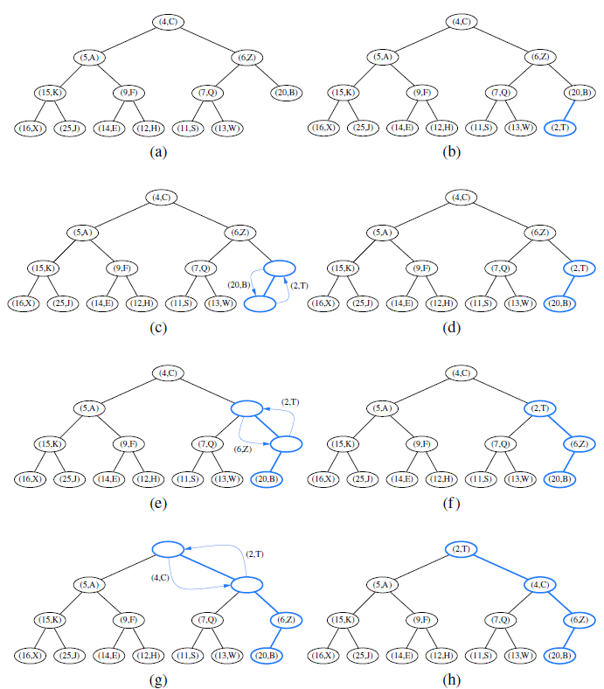
Insertion of a new entry with key 2 into the heap
initial heap;
(b) after adding a new node;
(c and( d) swap to locally restore the partial order property;
(e and f ) another swap; (g and h) final swap.

Slide 14
Array Implementation: removeMin
Element with smallest key is at root r of T: we cannot simply delete it
This would disrupt the binary tree structure
Replace root r with last node w of T, then delete the last node of the complete binary tree ADT
T may now violate the heap-order property.
If T has only one node (the root), then the algorithm terminates.
Otherwise, we distinguish between two cases:
If r has no right child, let s be the left child of r
Otherwise (r has both children), let s be a child of r with the smaller key
If k(r) ≤ k(s), the heap-order property is satisfied and the algorithm terminates.
If k(r) > k(s), then we need to restore the heap-order property,
achieved by swapping the entries stored at r and s.
down-heap bubbling : we may have to continue swapping down T until no violation of the heap-order property occurs.

Slide 15
Removal from a Heap
Method removeMin of the priority queue ADT corresponds to the removal of the root key from the heap
The removal algorithm consists of three steps
Replace the root key with the key of the last node w
Remove w
Restore the heap-order property (discussed next)
2
5
6
w
9
7
last node
7
5
w
6
9
new last node

Slide 16
Downheap
After replacing the root key with the key k of the last node, the heap-order property may be violated
Algorithm downheap restores the heap-order property by swapping key k along a downward path from the root
Upheap terminates when key k reaches a leaf or a node whose children have keys greater than or equal to k
Since a heap has height O(log n), downheap runs in O(log n) time
7
5
5
w
6
7
w
6
9
9

Slide 17
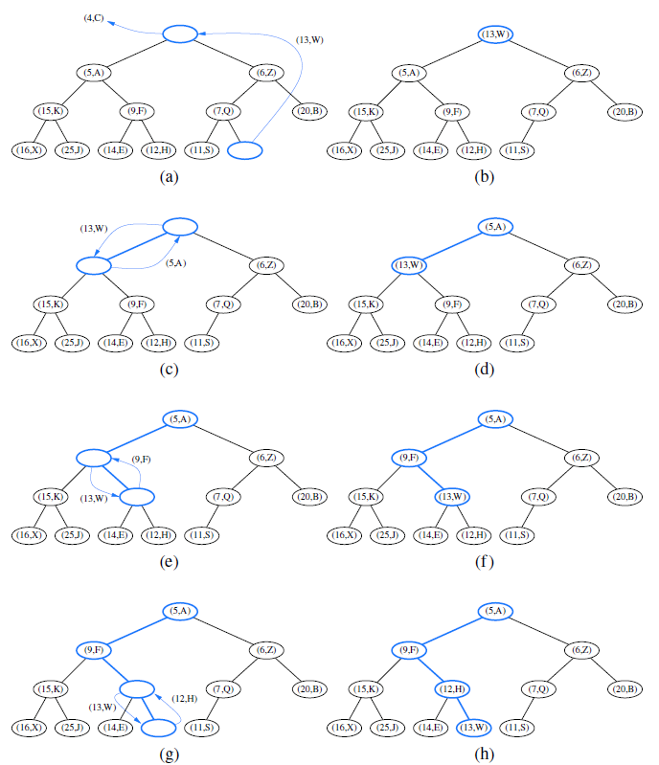
Removal of the entry with the smallest key from a heap
(a and b) deletion of the last node, whose entry gets stored into the root;
(c and d) swap to locally restore the heap-order property;
(e and f ) another swap;
(g and h) final swap.

Slide 18
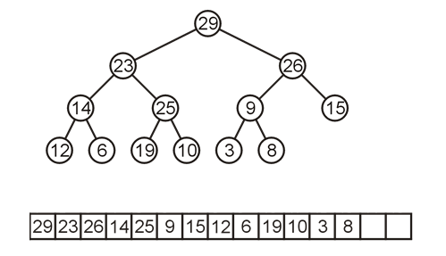
Binary Max Heaps
A binary max-heap is identical to a binary min-heap except that the parent is always larger than either of the children
For example, the same data as before stored as a max-heap yields

Slide 19
Heap Priority Queue
import java.util.*;
public class HeapPQ<K,V> {
/** primary collection of priority queue entries */
private ArrayList<Entry<K,V>> heap = new ArrayList<>();
private Comparator<K> comp;
// Creates an empty priority queue based on the natural ordering of its keys.
public HeapPQ() { comp = new DefaultComparator<K>(); }
// Creates an empty priority queue using the given comparator to order keys.
public HeapPQ(Comparator<K> c) { comp = c;}
public int size() { return heap.size(); }
public boolean isEmpty() { return size() == 0; }
private int parent(int j) { return (j-1) / 2; } // truncating division
private int left(int j) { return 2*j + 1; }
private int right(int j) { return 2*j + 2; }
private boolean hasLeft(int j) { return left(j) < heap.size(); }
private boolean hasRight(int j) { return right(j) < heap.size(); }
//Exchanges the entries at indices i and j of the array list. */
private void swap(int i, int j) {
Entry<K,V> temp = heap.get(i);
heap.set(i, heap.get(j));
heap.set(j, temp);
}

Slide 20
Heap Priority Queue
//Moves the entry at index j higher, if necessary, to restore the heap property.
private void upheap(int j) {
while (j > 0) { // continue until reaching root (or break statement)
int p = parent(j);
// heap property verified
if (compare(heap.get(j), heap.get(p)) >= 0) break;
swap(j, p);
j = p; // continue from the parent's location
}
}
// Moves the entry at index j lower, if necessary, to restore the heap property.
private void downheap(int j) {
while (hasLeft(j)) { // continue to bottom (or break statement)
int leftIndex = left(j);
int smallChildIndex = leftIndex; // although right may be smaller
if (hasRight(j)) {
int rightIndex = right(j);
if (compare(heap.get(leftIndex), heap.get(rightIndex)) > 0)
smallChildIndex = rightIndex; // right child is smaller
}
if (compare(heap.get(smallChildIndex), heap.get(j)) >= 0)
break; // heap property has been restored
swap(j, smallChildIndex);
j = smallChildIndex; // continue at position of the child
}
}

Slide 21
Heap Priority Queue
//Inserts a key-value pair and returns the entry created.
public Entry<K,V> insert(K key, V value) {
Entry<K,V> newest = new Entry<>(key, value);
heap.add(newest); // add to the end of the list
upheap(heap.size() - 1); // upheap newly added entry
return newest;
}
// returns an entry with minimal key.
public Entry<K,V> min() {
if (heap.isEmpty()) return null;
return heap.get(0);
}
//Removes and returns an entry with minimal key.
public Entry<K,V> removeMin() {
if (heap.isEmpty()) return null;
Entry<K,V> answer = heap.get(0);
swap(0, heap.size() - 1); // put minimum item at the end
heap.remove(heap.size() - 1); // and remove it from the list;
downheap(0); // then fix new root
return answer;
}
// Method for comparing two entries according to key
public int compare(Entry<K,V> a, Entry<K,V> b) {
return comp.compare(a.getKey(), b.getKey());
}
}

Slide 22
Heap Priority Queue
public class Student{
private String firstName;
private String lastName;
private Integer studentId;
public Student(){}
public Student( String fname, String lname, int id) {
firstName = fname;
lastName = lname;
studentId = id;
}
public String getFirstName (){return firstName;}
public String getLastName (){return lastName;}
public Integer getStudentId (){return studentId;}
public void setFirstName (String fname){firstName=fname;}
public void setLastName (String lname){lastName=lname;}
public void setStudentId (int id){studentId=id;}
public String toString(){
return "" + studentId + " " + firstName + " " + lastName;
}
}

Slide 23
Heap Priority Queue
HeapPQ<Integer, Student> PQ = new HeapPQ<>();
Student s1 = new Student("Mike", "Smith", 100);
Student s2 = new Student("Ali", "Ward", 90);
Student s3= new Student("Hadi", "Audi", 200);
Student s4= new Student("Laure", "Fani", 10);
Student s5= new Student("Omar", "BenKhodor", 9);
Student s6= new Student("Robert", "Deniro", 20);
PQ.insert(s1.getStudentId(), s1);
PQ.insert(s2.getStudentId(), s2);
PQ.insert(s3.getStudentId(), s3);
PQ.insert(s4.getStudentId(), s4);
PQ.insert(s5.getStudentId(), s5);
PQ.insert(s6.getStudentId(), s6);
while (!PQ.isEmpty()){
System.out.print(PQ.removeMin().getValue().toString()+"; ");
}
System.out.println();

Slide 24
Heap Sort
Recall that inserting n objects into a min-heap and then taking n objects will result in them coming out in order
Strategy: given an unsorted list with n objects,
place them into a heap,
and take them out
Run time Analysis of Heap Sort
Taking an object out of a heap with n items requires O(log(n)) time
Therefore, taking n objects out requires O(n log(n))
This solution requires O(n) additional memory
in-place : Instead of transferring elements out of the list and then back in, we simply rearrange them

Slide 25
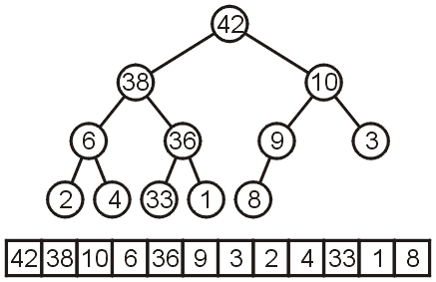

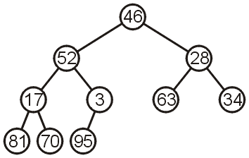
In-place Implementation
Instead of implementing a min-heap, consider a max-heap:
A heap where the maximum element is at the top of the heap and the next to be popped
In-place Heapification
Now, consider this unsorted array:
This array represents the following complete tree:
This is neither a min-heap or max-heap
Remember arrays start at 0 , and formulas are :
Children 2*k + 1 and 2*k + 2
Parent (k - 1)/2

Slide 26
Bottom-Up Heap Construction
Can we convert this complete tree into a max heap?
Restriction: The operation must be done in-place
Bottom-Up Heap Construction:
note that all leaf nodes are already max heaps,
and then make corrections so that previous nodes also form max heaps

Slide 27
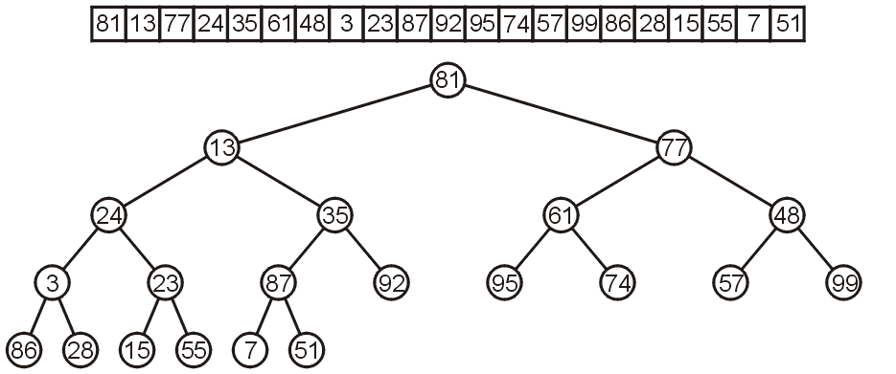
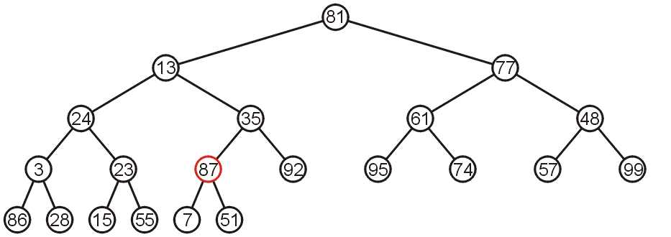
Bottom-Up Heap Construction
Let’s work bottom-up: each leaf node is a max heap on its own
Also, the subtree with 87 as the root is a max-heap

Slide 28
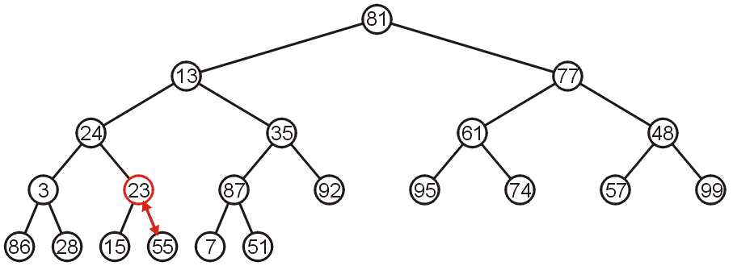
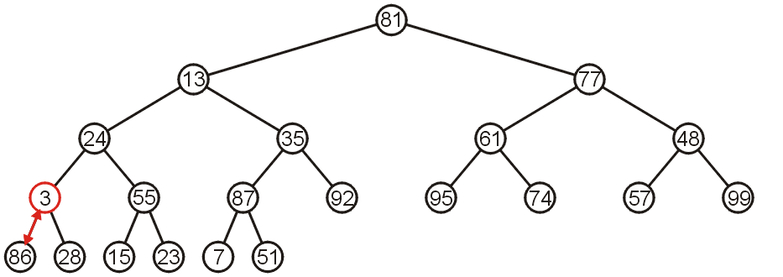
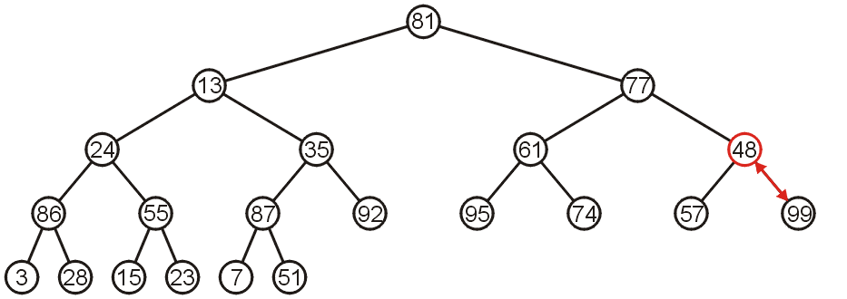
Bottom-Up Heap Construction
The subtree with 23 is not a max-heap, but swapping it with 55 creates a max-heap
This process is termed down-heap bubbling
The subtree with 3 as the root is not max-heap, but we can swap 3 and the maximum of its children: 86
Starting with the next higher level, the subtree with root 48 can be turned into a max-heap by swapping 48 and 99

Slide 29
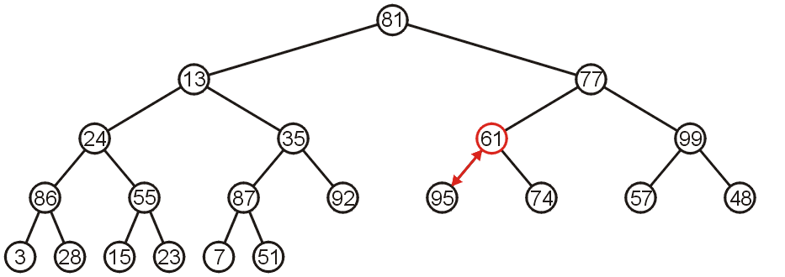
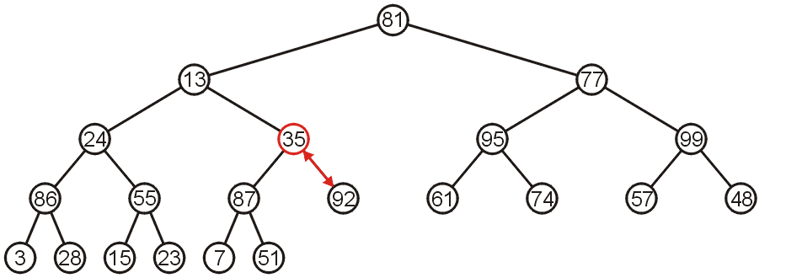
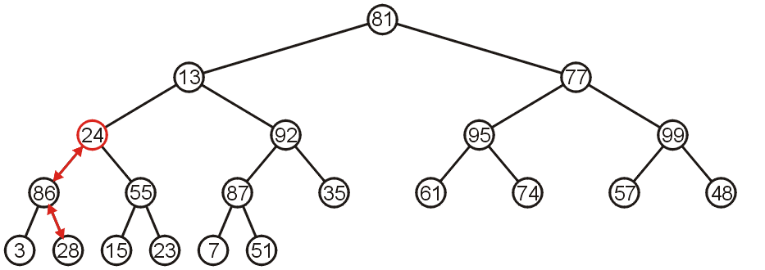
Bottom-Up Heap Construction
Similarly, swapping 61 and 95 creates a max-heap of the next subtree
As does swapping 35 and 92
The subtree with root 24 may be converted into a max-heap by first swapping 24 and 86 and then swapping 24 and 28

Slide 30
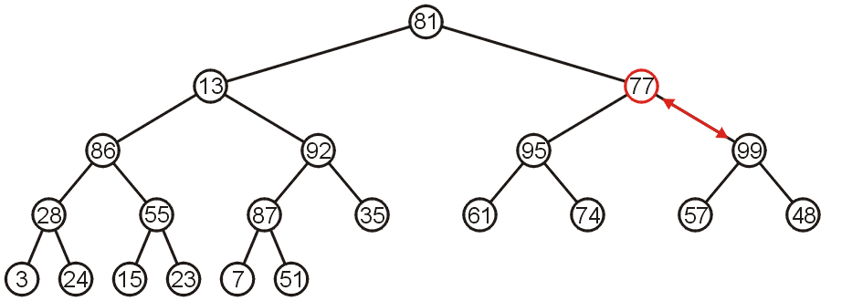
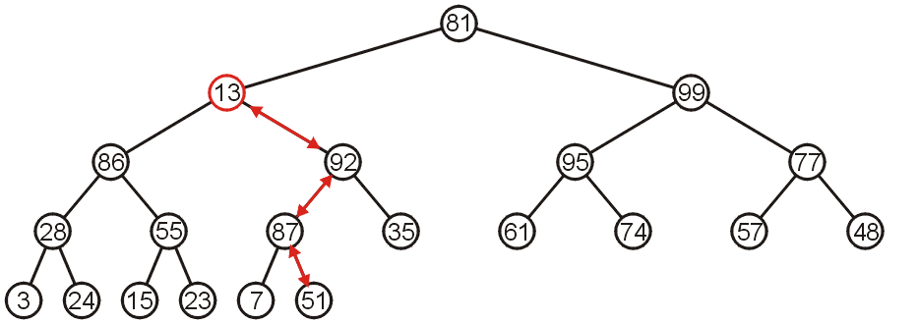
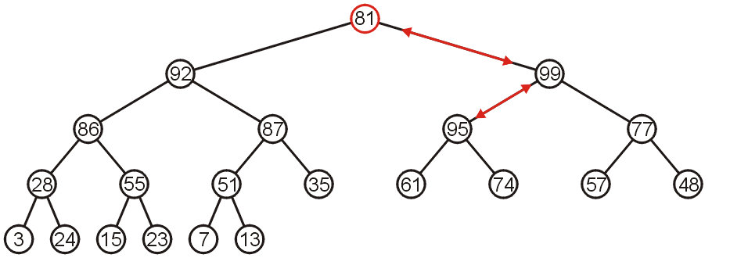
Bottom-Up Heap Construction
The right-most subtree of the next higher level may be turned into a max-heap by swapping 77 and 99
However, to turn the next subtree into a max-heap requires that 13 be down-heap bubbled to a leaf node
The root need only be down-heap bubbled by two levels

Slide 31
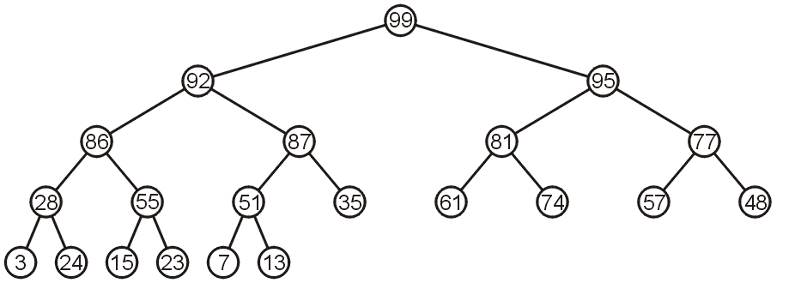
Bottom-Up Heap Construction
The final product is a max-heap

Slide 32
// Creates a priority queue initialized with the respective key-value pairs.
// The two arrays will be paired element-by-element. They are presumed to have the same
// length. (If not, entries will be created only up to the length of the shorter of the arrays)
public HeapPQ(K[] keys, V[] values) {
comp = new DefaultComparator<K>();
for (int j=0; j < Math.min(keys.length, values.length); j++)
heap.add(new Entry<>(keys[j], values[j]));
heapify();
}
// Performs a bottom-up construction of the heap in linear time.
private void heapify() {
int startIndex = parent(size()-1); // start at PARENT of last entry
for (int j=startIndex; j >= 0; j--) // loop until processing the root
downheap(j);
}

Slide 33
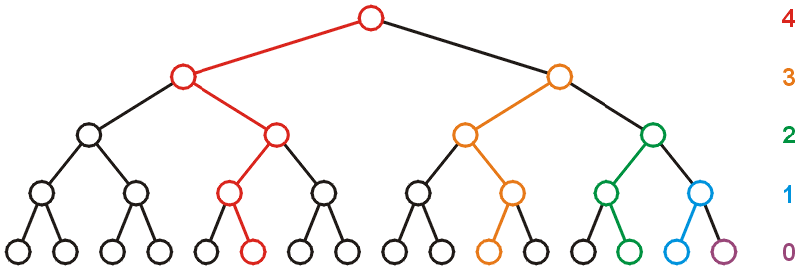
Run-time Analysis of Bottom-Up Heap Construction
Considering a perfect tree of height h:
The maximum number of swaps which a second-lowest level would experience is 1, the next higher level, 2, and so on
At depth k, there are 2^{k} nodes and in the worst case, all of these nodes would have to be bubbled down h – k levels
In the worst case, this would requiring a total of 2^{k}(h – k) swaps
Writing this sum mathematically, we get:
Recall that for a perfect tree, n = 2^{h + 1} – 1 and h + 1 = lg(n + 1), therefore
Each swap requires two comparisons (which child is greatest), so there is a maximum of 2n (or O(n)) comparisons
Notes:
S= h + 2(h − 1) + 4(h − 2) + 8(h − 3) + 16(h − 4)+· · ·+2^{h−2} (2)+2^{h−1} (1)
2S=2h + 4(h − 1) + 8(h − 2) + 16(h − 3)+· · ·2^{h−1} (2)+2^{h}(1)
2S –S we notice that some terms almost cancel
2h − 2(h − 1) = 2,
4(h − 1) − 4(h − 2) = 4
8(h − 2) - 8(h − 3) =8
2^{h−1} (2) - 2^{h−1} =2^{h−1}
And so on
2
S=2S-S= -h + 2 + 4 + 8+· · ·+2^{h−1} + 2^{h} =
=-h -1 +1 + 2 + 4 + 8+· · ·+2^{h−1} + 2^{h} = -(h+1) + = (2^{h+1} − 1)
= (2^{h+1} − 1) − (h + 1)

Slide 34
Run-time Analysis of Bottom-Up Heap Construction
S= h + 2(h − 1) + 4(h − 2) + 8(h − 3) + 16(h − 4)+· · ·+2^{h−2} (2)+2^{h−1} (1)
2S=2h + 4(h − 1) + 8(h − 2) + 16(h − 3)+· · ·2^{h−1} (2)+2^{h}(1)
S= 2S –S we notice that some terms almost cancel
2h − 2(h − 1) = 2,
4(h − 1) − 4(h − 2) = 4
8(h − 2) - 8(h − 3) =8
...
2^{h−1} (2) - 2^{h−1} =2^{h−1}
S = 2S-S = -h + 2 + 4 + 8+· · ·+2^{h−1} + 2^{h}
=-h -1 +1 + 2 + 4 + 8+· · ·+2^{h−1} + 2^{h}
= -(h+1) + (2^{h+1} − 1)
= (2^{h+1} − 1) − (h + 1)
Notes:
S= h + 2(h − 1) + 4(h − 2) + 8(h − 3) + 16(h − 4)+· · ·+2^{h−2} (2)+2^{h−1} (1)
2S=2h + 4(h − 1) + 8(h − 2) + 16(h − 3)+· · ·2^{h−1} (2)+2^{h}(1)
2S –S we notice that some terms almost cancel
2h − 2(h − 1) = 2,
4(h − 1) − 4(h − 2) = 4
8(h − 2) - 8(h − 3) =8
2^{h−1} (2) - 2^{h−1} =2^{h−1}
And so on
S=2S-S= -h + 2 + 4 + 8+· · ·+2^{h−1} + 2^{h} =
=-h -1 +1 + 2 + 4 + 8+· · ·+2^{h−1} + 2^{h} = -(h+1) + = (2^{h+1} − 1)
= (2^{h+1} − 1) − (h + 1)

Slide 35
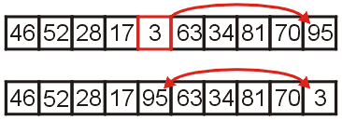
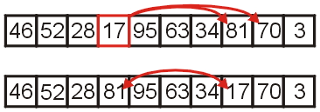
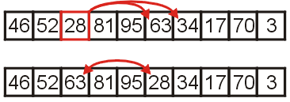
Example Heap Sort
Convert the unordered array with n = 10 elements into a max-heap
None of the leaf nodes need to be bubbled down, and the first non-leaf node is in position n/2
Thus we start with position 10/2 = 5
We compare 3 with its child and swap them
We compare 17 with its two children and swap it with the maximum child (70)
We compare 28 with its two children, 63 and 34, and swap it with the largest child

Slide 36
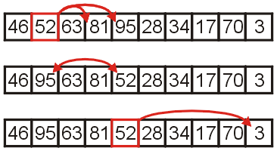
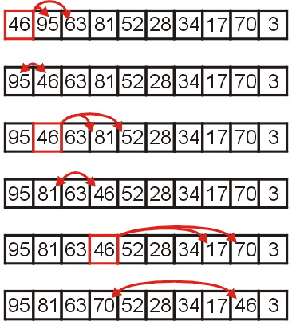
Example Heap Sort
We compare 52 with its children, swap it with the largest
Recursing, no further swaps are needed
Finally, we swap the root with its largest child, and recurse, swapping 46 again with 81, and then again with 70

Slide 37
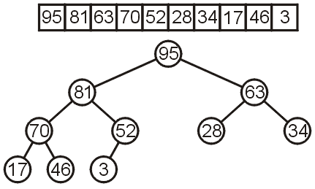

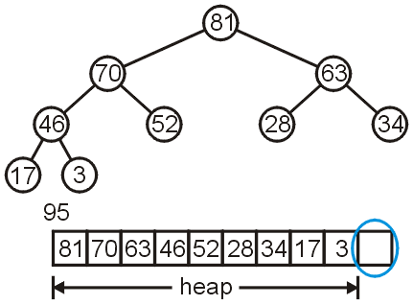
Heap Sort Example
We have now converted the unsorted array into a max-heap:
Suppose we remove the maximum element of this heap
This leaves a gap at the back of the array:

Slide 38

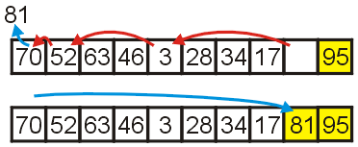
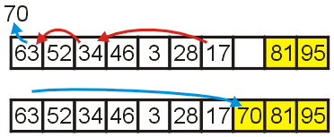
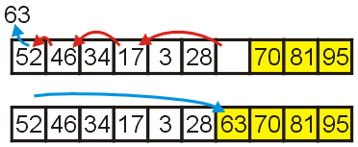
Heap Sort Example
This is the last entry in the array, so why not fill it with the largest element?
Repeat this process: remove the maximum element, and then insert it at the end of the array:
Repeat this process
remove and append 70
remove and append 63

Slide 39
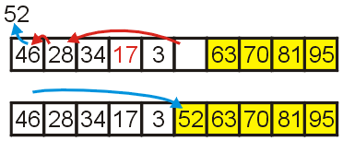
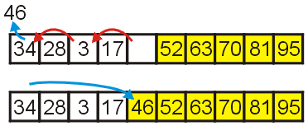
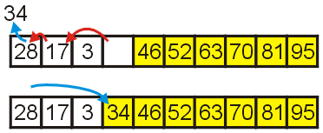
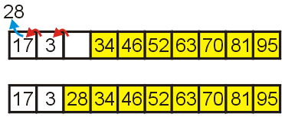
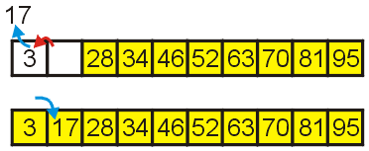
Heap Sort Example
We have the 4 largest elements in order
remove and append 52
remove and append 46
remove and append 34
remove and append 28
Finally, we can remove 17, insert it into the 2nd location, and the resulting array is sorted

